Slide 1
BITstarDis

Slide 2
Content
BIT* Algorithm
  Heuristic Cost
  main parts of algorithm
Animation of BIT*
BIT* in practice
  Prune
  priority queue of vertex
  Just-In-Time sampling
BITstarDis

Slide 3
BIT* Algorithm

Slide 4
paper
Batch Informed Trees (BIT*): Sampling-based Optimal Planning via the Heuristically Guided Search of Implicit Random Geometric Graphs
Jonathan D. Gammell1, Siddhartha S. Srinivasa2, and Timothy D. Barfoot1
https://arxiv.org/abs/1405.5848

Slide 5
if Qe.empty() and Qv.empty(){
Prune(g_t(x_g));
X_samples.addSample(m,g_t(x_g));
V_old <- V;
Qv <- V;
r = radius(|V|+|X_samples|);}
while BestQueueValue(Qv) <= BestQueueValue(Qe) :
ExpandVertex(BestInQueue(Qv))
if g_t(v) + c_hat(v,x) + h_hat(x) < g_t(x_g){
if g_hat(v) + c(v,x) + h_hat(x) < g_t(x_g){
if g_t(v) + c(v,x) < g_t(x){
if x in Vertices{
Edges.delete(x,v_any);
}else{
Vertices.add(x), X_samples.delete(x);
QueueVertex.add(x); }
Edeges.add((v,x));
QueueEdge.delete((v_any,x) that g_t(v_any)+c_hat(v_any,x) >= g_t(x)) } } }

Slide 6
def QueueValue(v):
return g_t(v) + h_hat(v)
def QueueValue((v,x)):
return g_t(v) + c_hat(v,x) + h_hat(x)
def ExpandVertex(v):
Qv.delete(v)
X_near ={x in X_samples that ||x-v||<=r}
Qe.add((v,x) that x in X_near and g_hat(v) + c_hat(v,x) + h_hat(x) < g_t(x_g))
if v is new in this batch (v is not in V_old):
V_near = {v in Vertices that ||w-v||<=r}
Qe.add((v,w) that g_hat(v) + c_hat(v,w) + h_hat(w) < g_T(x_g) and g_t(v) + c_hat(v,w) < g_t(w))
def Prune(c=g_t(x_g)):
X_samples.delete(x that f_hat(x)>=c)
Vertices.delete(v that f_hat(v)>c)
Edges.delete((v,w) that f_hat(v)>c or f_hat(w)>c)
X_samples.add(v in Vertices that are not connected)
Vertices.delete(v that are not connected)

Slide 7
heuristic cost

Slide 8
vertex cost
f(x) cost
  g(x) cost-to-come
  h(x) cost-to-go
heuristic
  use hat to represent heuristic

Slide 9
xG
X_samples
Edges
Vertices
Qe
Qv
xI

Slide 10
cost-to-come
xG
X_samples
Edges
Vertices
Qe
Qv
g_t(x)=∞
g_hat(v)
xI
g_t(v)

Slide 11
cost-to-go
h_hat(v)
xG
X_samples
Edges
Vertices
Qe
Qv
xI
Notes:
of course, we don’t know the true cost-to-go, so we only have h_hat(v)

Slide 12
Queue value / current heuristic
QueueValue(v) = g_t(v) + h_hat(v)
QueueValue((v,x)) = g_t(v) + c_hat(v,x) + h_hat(x)

Slide 13
QueueValue(v) = g_t(v) + h_hat(v)
xG
h_hat(v)
X_samples
Edges
Vertices
Qe
Qv
xI
g_t(v)
Notes:
of course, we don’t know the true cost-to-go, so we only have h_hat(v)

Slide 14
QueueValue((v,x))
= g_t(v) + c_hat(v,x) + h_hat(x)
xG
h_hat(x)
c_hat(v,x)
c(v,x) = ∞
X_samples
Edges
Vertices
Qe
Qv
c_hat(v,x)
xI
g_t(v)
Notes:
of course, we don’t know the true cost-to-go, so we only have h_hat(v)

Slide 15
lower-bound heuristic
current heuristic
  considering the current graph/tree
  have the possibility to improve the graph
lower-bound heuristic
  most ideal situation
  have the possibility to improve the solution

Slide 16
lowerBoundHeuristicVertex
xG
h_hat(v)
X_samples
Edges
Vertices
Qe
Qv
g_hat(v)
xI
Notes:
of course, we don’t know the true cost-to-go, so we only have h_hat(v)

Slide 17
lowerBoundHeuristicEdge
xG
h_hat(x)
X_samples
Edges
Vertices
Qe
Qv
c_hat(v,x)
g_hat(v)
xI
Notes:
of course, we don’t know the true cost-to-go, so we only have h_hat(v)

Slide 18
main parts of algorithm

Slide 19
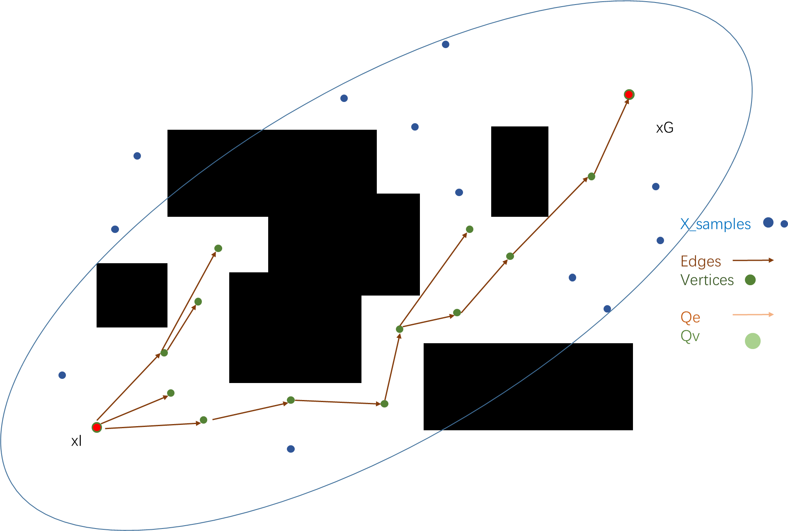
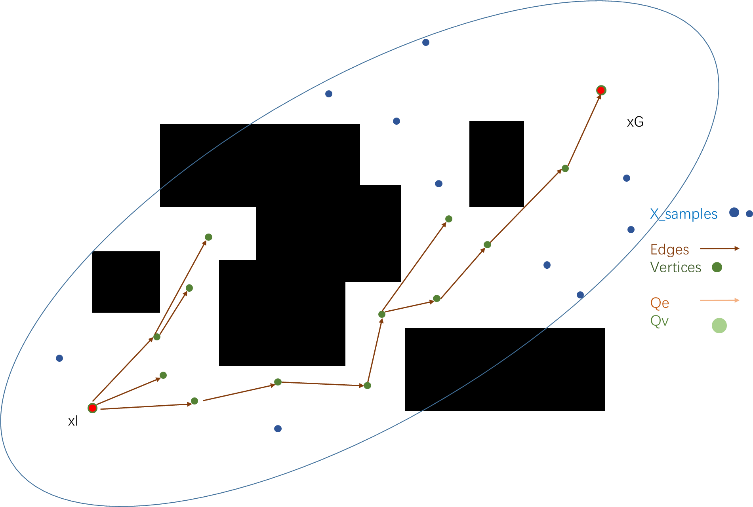
batch initialization
Prune(g_t(x_g));
Sample(m,g_t(x_g));
Qv = Vetices;
r = radius(|V|+|X_samples|);
Prune

Slide 20
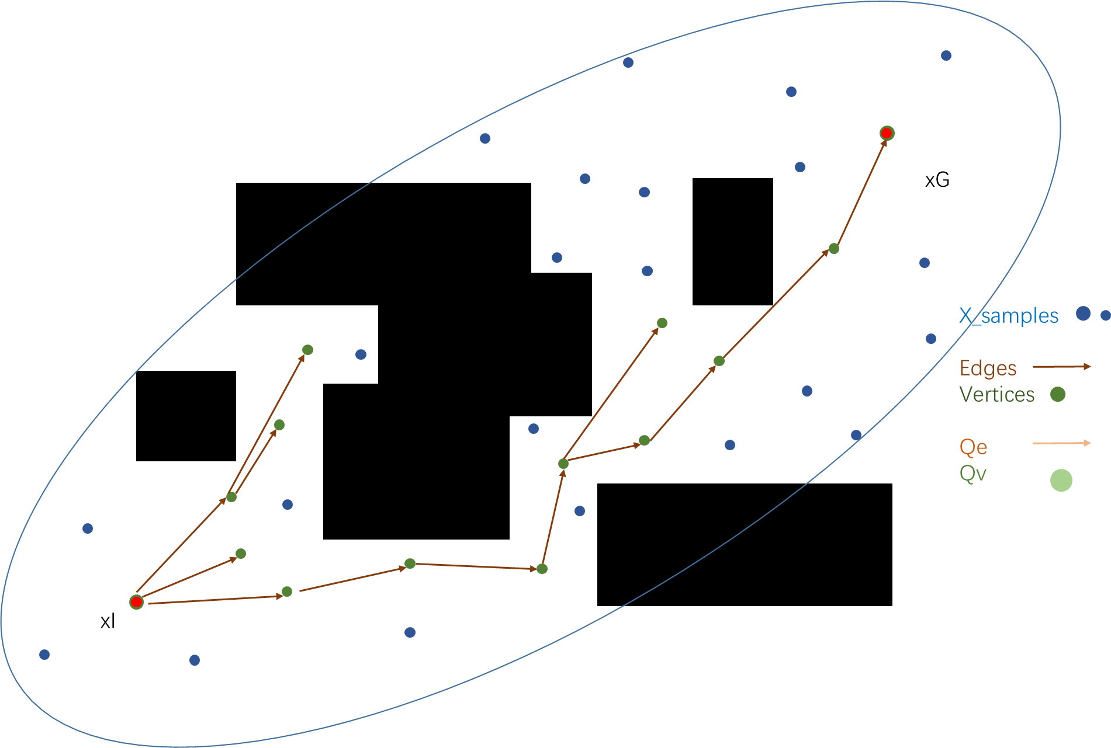
batch initialization
Prune(g_t(x_g));
Sample(m,g_t(x_g));
Qv = Vetices;
r = radius(|V|+|X_samples|);
Sample

Slide 21
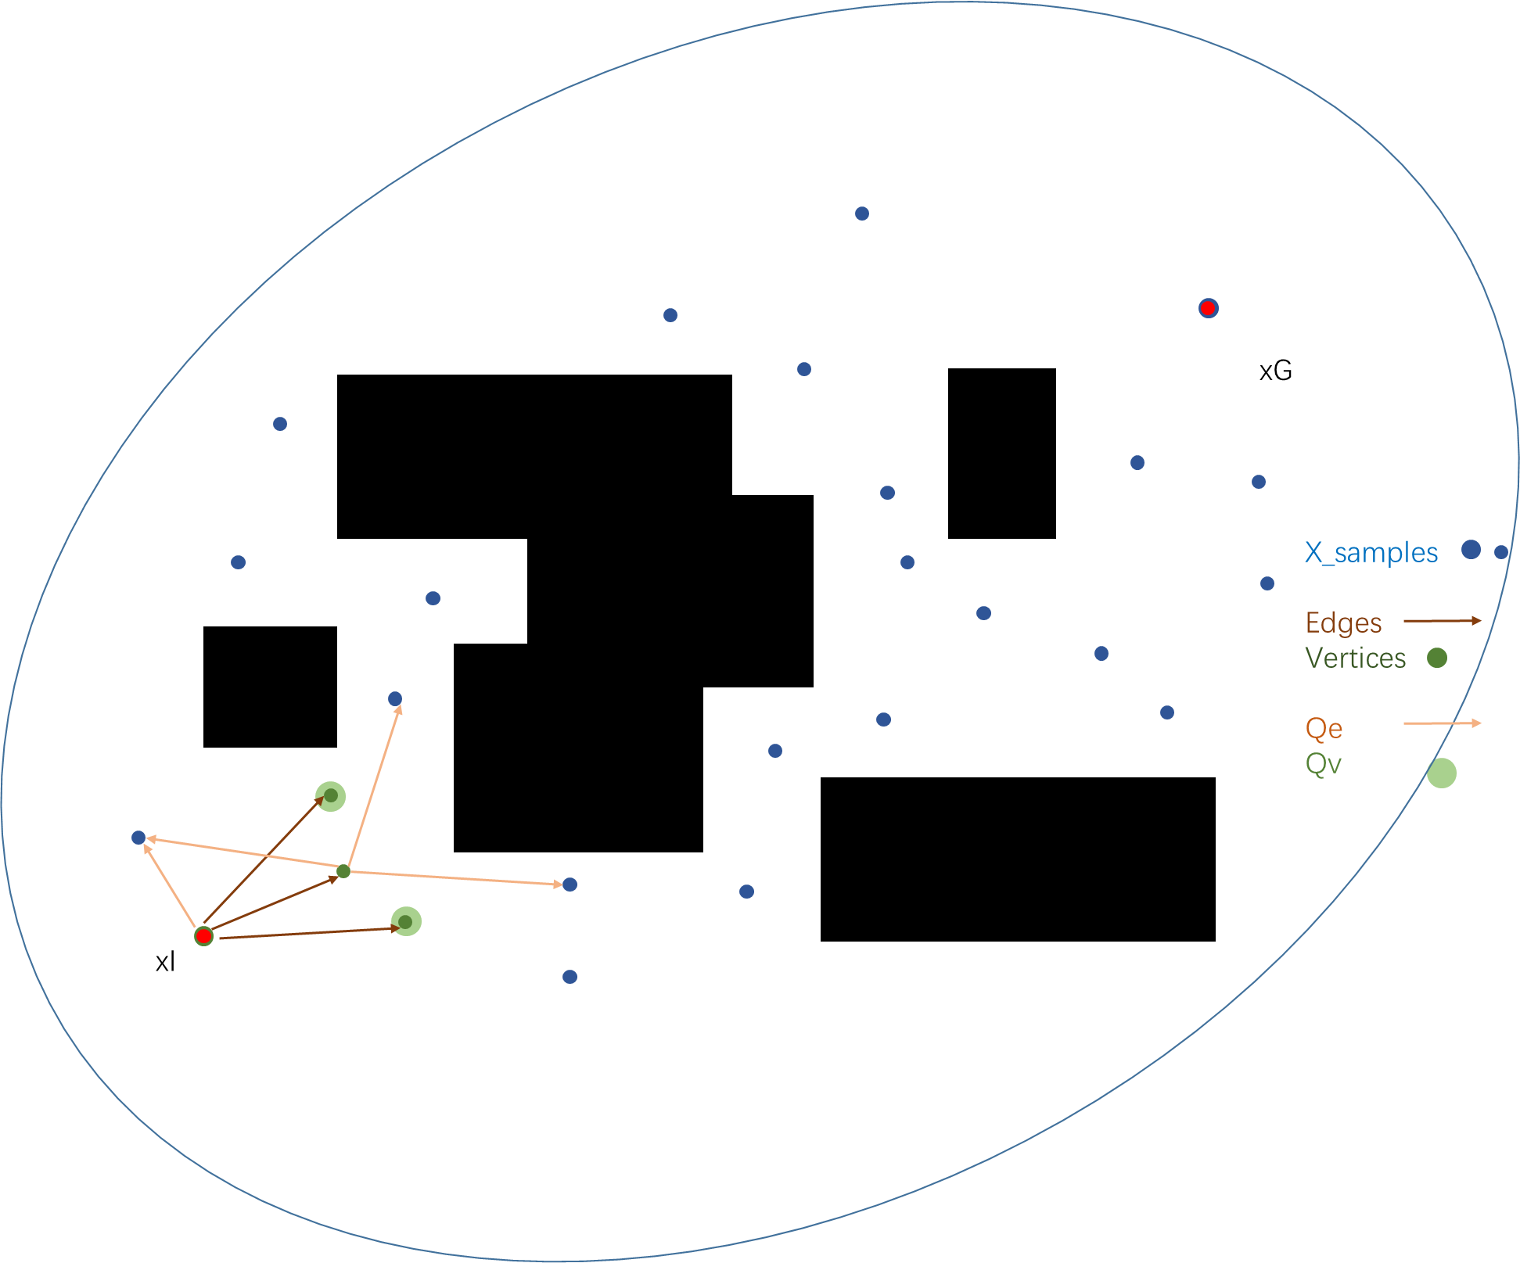
Expansion: Qe & Qv

Slide 22
Expansion
while |Qv| or |Qe|:
while BestQueueValue(Qv) <= BestQueueValue(Qe) :
ExpandVertex(BestInQueue(Qv))
ExpandEdge(BestInQueue(Qe))

Slide 23
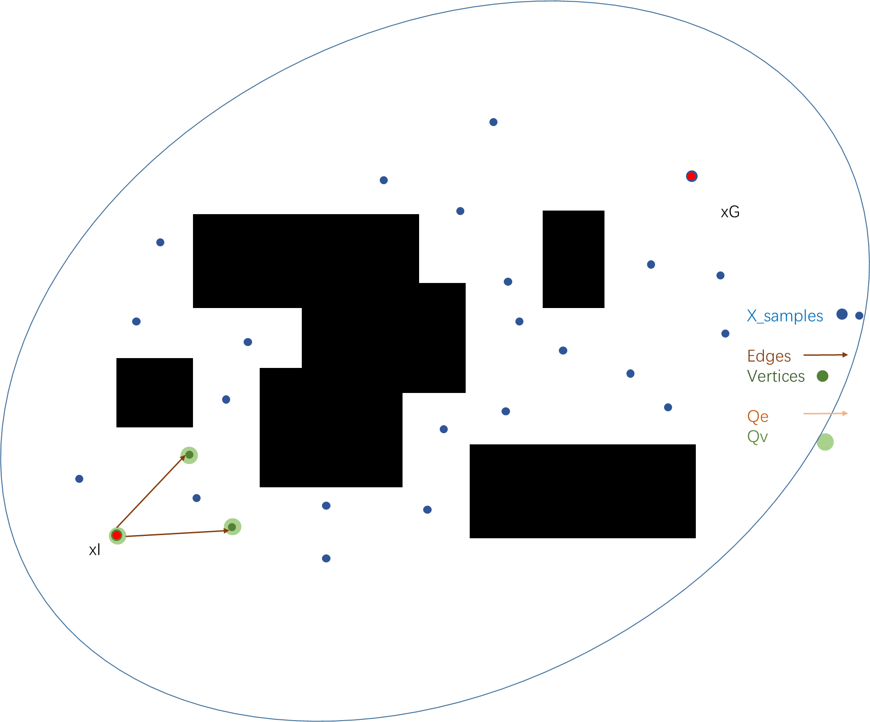
Expansion – Vertex Expand
ExpandVertex(v):
X_near ={x in X_samples that ||x-v||<=r}
Qe.add{(v,x) that x in X_near and
g_hat(v) + c_hat(v,x) + h_hat(x) < g_t(x_g)}
if v is new in this batch (v is not in V_old):
V_near = {v in Vertices that ||w-v||<=r}
Qe.add{(v,w) that
g_hat(v) + c_hat(v,w) + h_hat(w) < g_T(x_g) and
g_t(v) + c_hat(v,w) < g_t(w)}

Slide 24
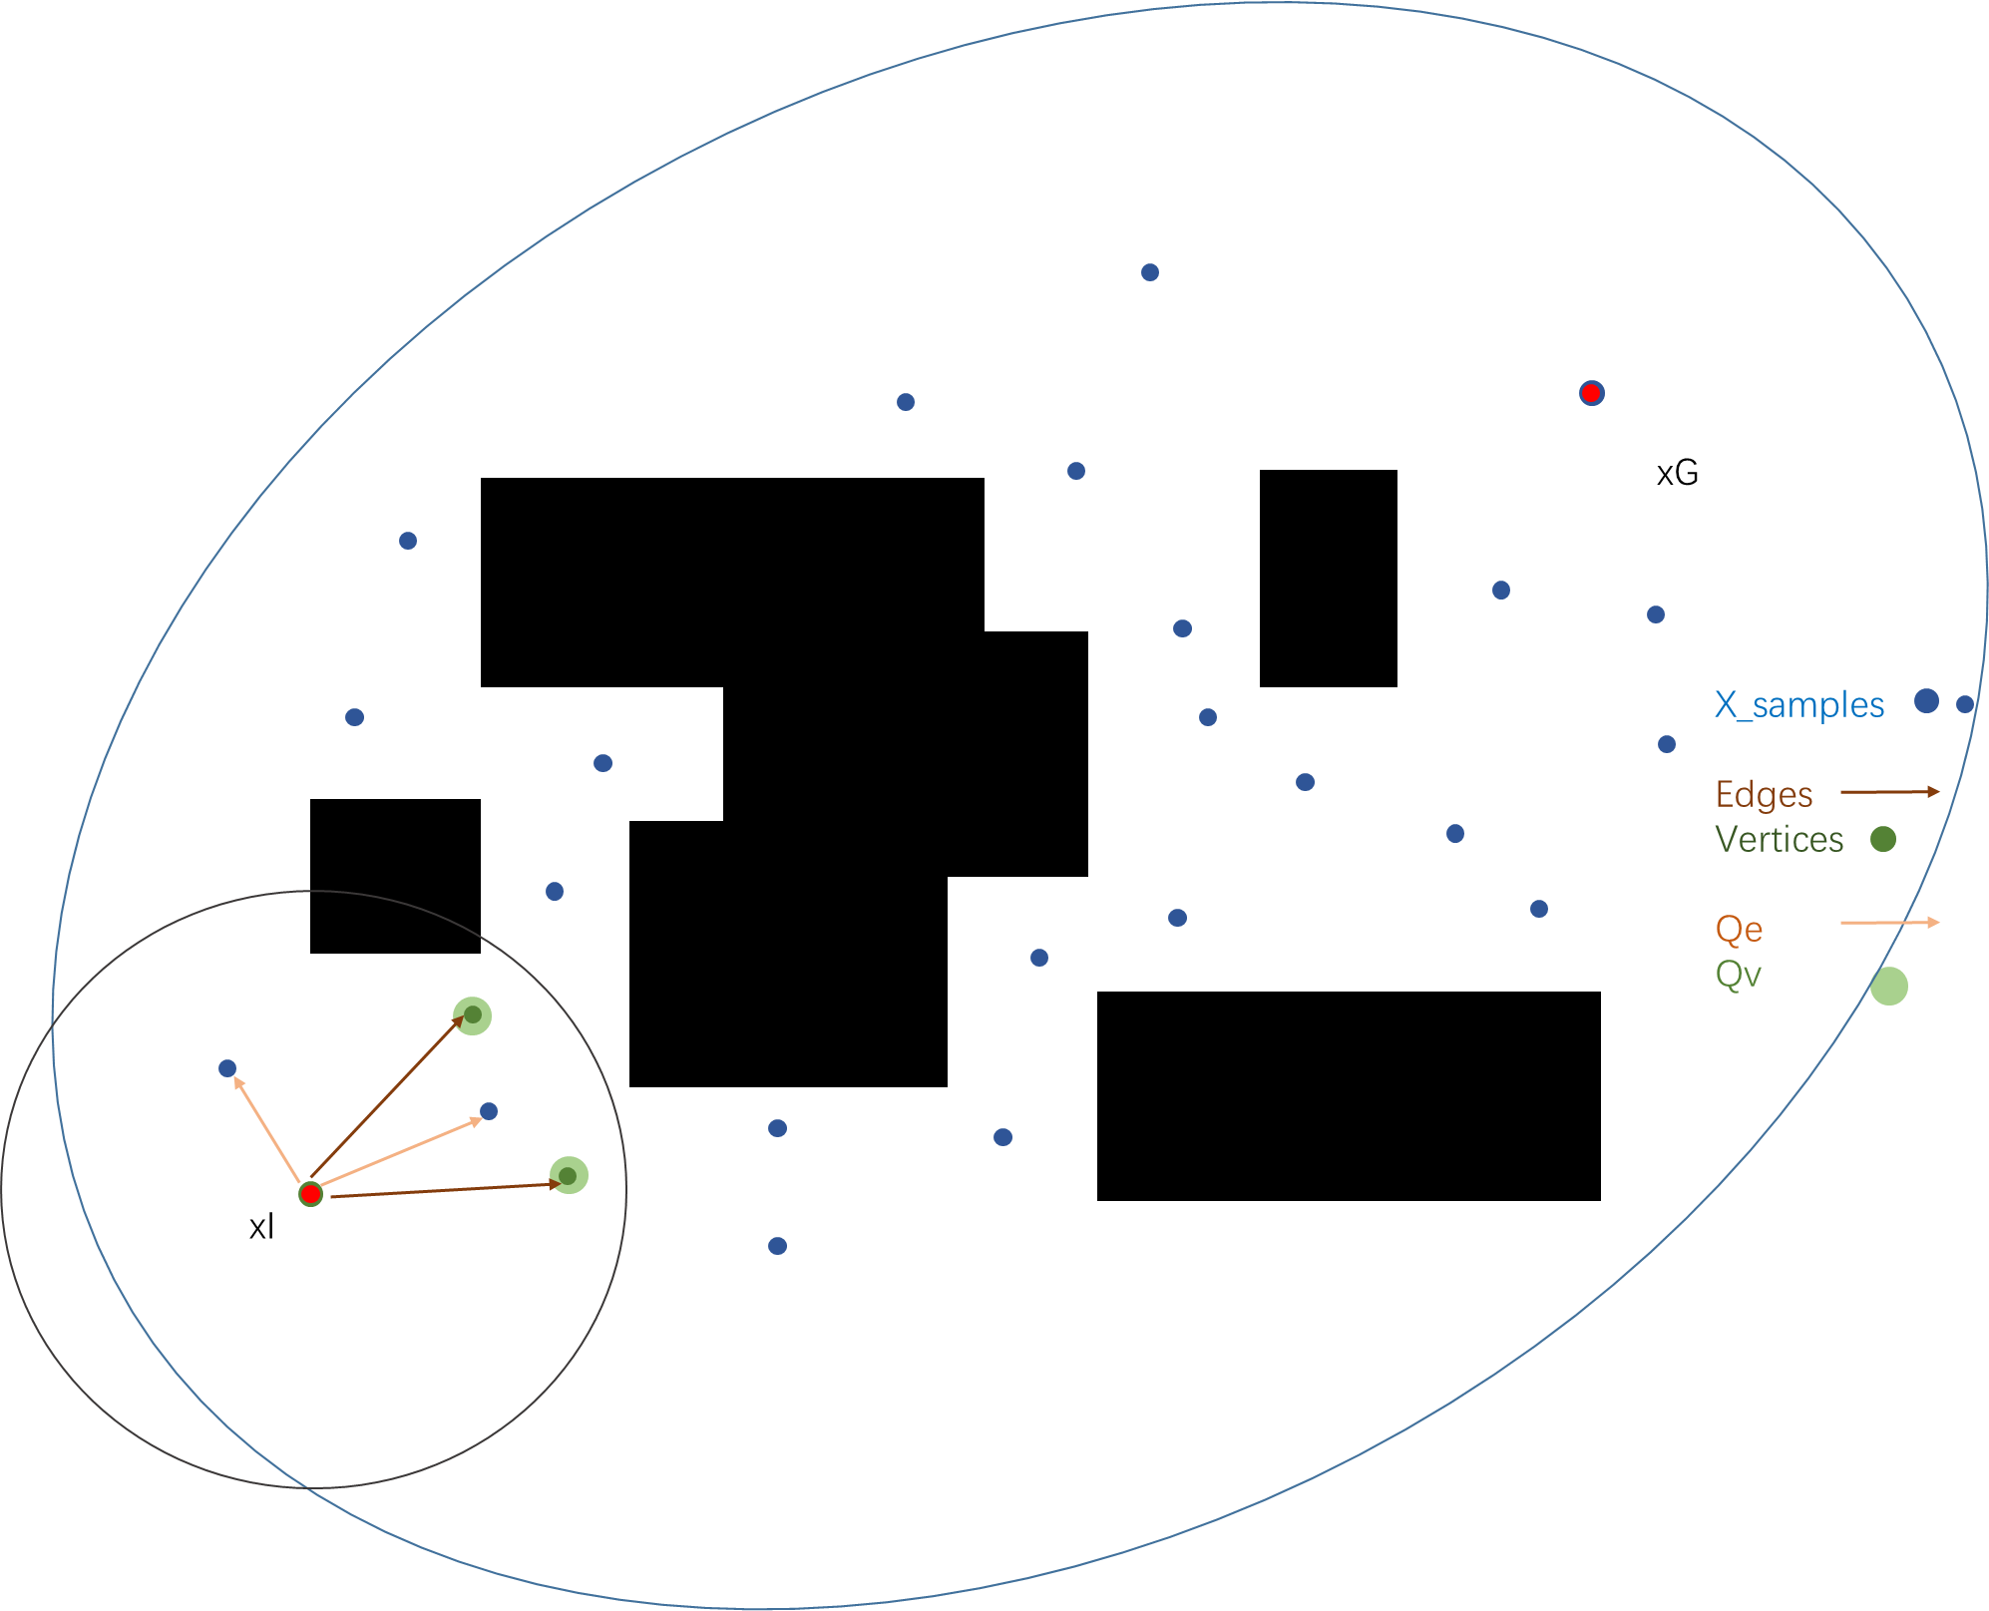
Expansion – Vertex Expand
ExpandVertex(v):
X_near ={x in X_samples that ||x-v||<=r}
Qe.add{(v,x) that x in X_near and
g_hat(v) + c_hat(v,x) + h_hat(x) < g_t(x_g)}
if v is new in this batch (v is not in V_old):
V_near = {v in Vertices that ||w-v||<=r}
Qe.add{(v,w) that
g_hat(v) + c_hat(v,w) + h_hat(w) < g_T(x_g) and
g_t(v) + c_hat(v,w) < g_t(w)}

Slide 25
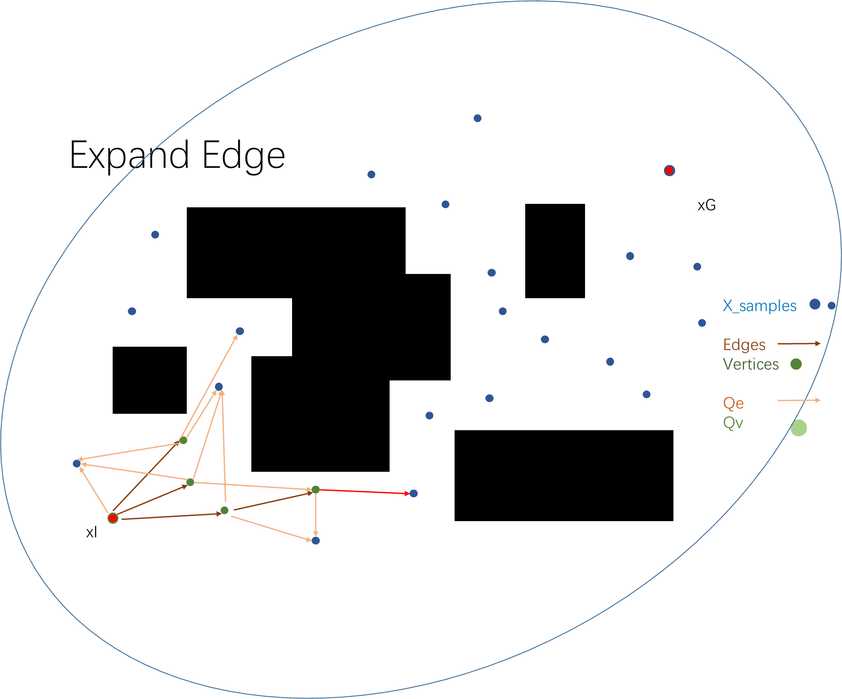
Expansion – Edge Expand
(v,x) = QueueEdge.pop()
if g_t(v) + c_hat(v,x) + h_hat(x) < g_t(x_g){// improve the solution
if g_hat(v) + c(v,x) + h_hat(x) < g_t(x_g){// improve the solution
if g_t(v) + c(v,x) < g_t(x){// improve the graph
if x in Vertices{
Edges.delete(x,v_any);
}else{
Vertices.add(x), X_samples.delete(x);
QueueVertex.add(x); }
Edges.add((v,x));

Slide 26
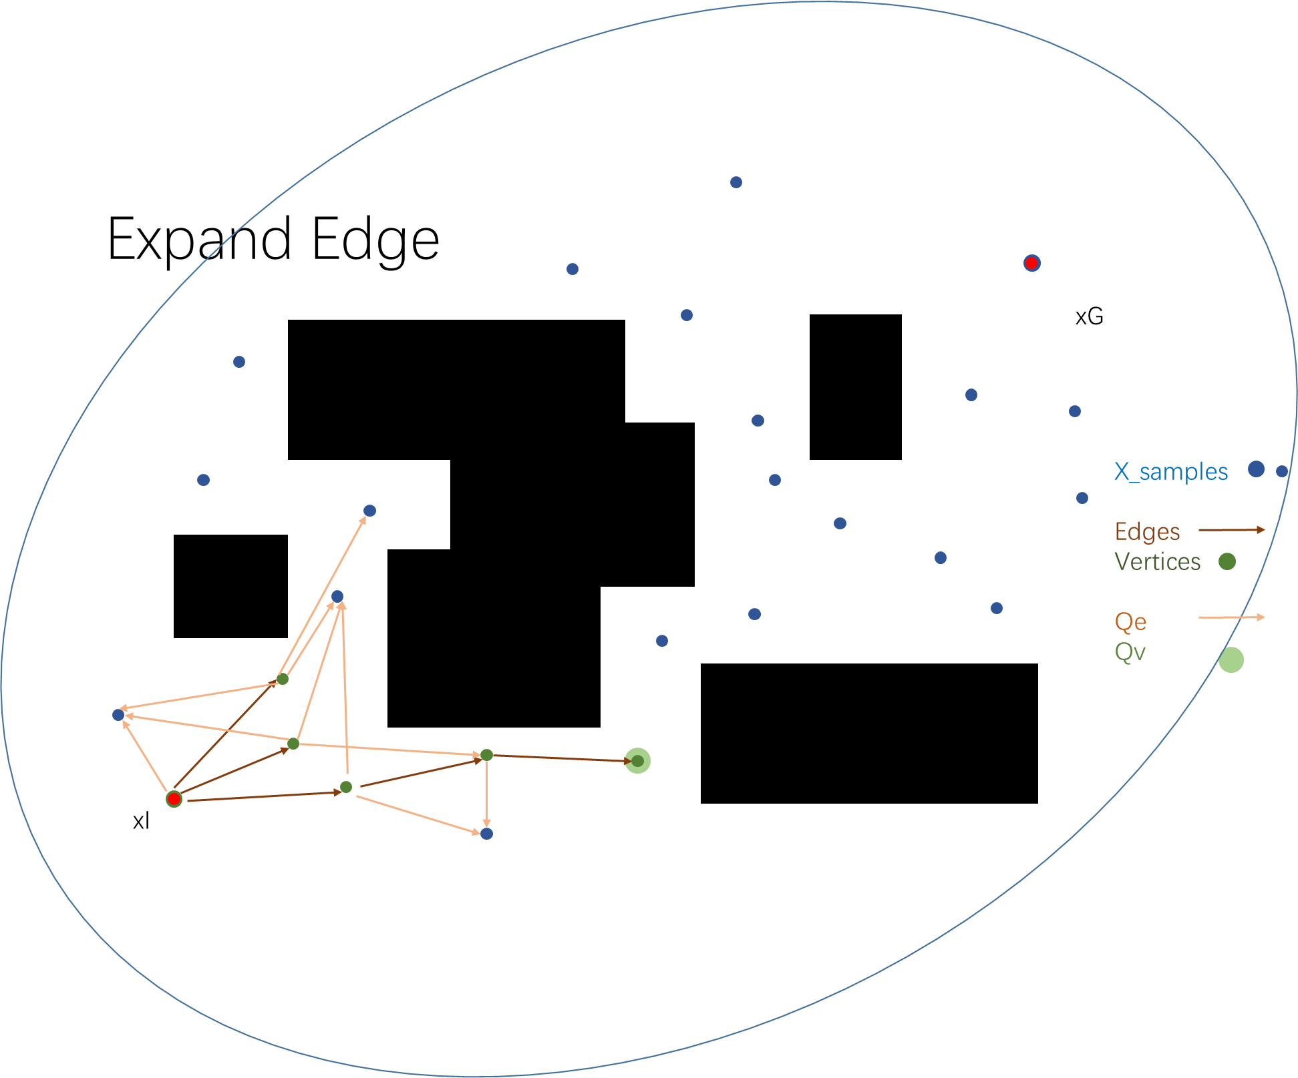
Expansion – Edge Expand
(v,x) = QueueEdge.pop()
if g_t(v) + c_hat(v,x) + h_hat(x) < g_t(x_g){// improve the solution
if g_hat(v) + c(v,x) + h_hat(x) < g_t(x_g){// improve the solution
if g_t(v) + c(v,x) < g_t(x){// improve the graph
if x in Vertices{
Edges.delete(x,v_any);
}else{
Vertices.add(x), X_samples.delete(x);
QueueVertex.add(x); }
Edges.add((v,x));

Slide 27
animation

Slide 28
Map
xG
xI

Slide 29
Initialization
Vertices ← xI
X_samples ← xG
xG
X_samples
Edges
Vertices
Qe
Qv
xI

Slide 30
Sample
X_samples ←+← Sample(samplesPerBatch_, g_t(x_g))
xG
X_samples
Edges
Vertices
Qe
Qv
xI
Notes:
this is original code;
see JIT sample later.

Slide 31
Queue Vertex
Qv ← Vertices
xG
X_samples
Edges
Vertices
Qe
Qv
xI
Notes:
this is original code;
see JIT sample later.

Slide 32
Expanding Queue
while BestQueueValue (QV ) < BestQueueValue (QE) :
ExpandVertex (BestInQueue (QV ))
xG
X_samples
Edges
Vertices
Qe
Qv
xI

Slide 33
Expand Vertex
Qe ←+← V x X_near, (V x V_near)
enqueuer condition:
lower-bound heuristic cost < g_t(x_goal)
xG
X_samples
Edges
Vertices
Qe
Qv
xI
Notes:
for vertex, there’s more condition to fit. but we don’t have a Vnear yet …

Slide 34
Expand Vertex
while BestQueueValue (QV ) < BestQueueValue (QE) :
ExpandVertex (BestInQueue (QV ))
xG
X_samples
Edges
Vertices
Qe
Qv
xI
Notes:
break the loop

Slide 35
Expand Edge
(vm,xm) = BestInQueue(Qe)
xG
X_samples
Edges
Vertices
Qe
Qv
xI
Notes:
break the loop

Slide 36
Expand Edge
improve the solution
if g_t (vm) + c_hat (vm, xm) + h_hat (xm) < g_t(xgoal)
if g_hat(vm) + c (vm, xm) + h_hat (xm) < g_t(xgoal)
if g_t (vm) + c (vm, xm) < g_t (xm)
improve the graph
xG
X_samples
Edges
Vertices
Qe
Qv
xI

Slide 37
Add Edge
xG
X_samples
Edges
Vertices
Qe
Qv
xI
Notes:
prune if needed

Slide 38
这个图有BUG，
但我不想重新画了😰
所以……
假装没看到吧😂

Slide 39
new edge
xG
X_samples
Edges
Vertices
Qe
Qv
xI
Notes:
since Qv is exhausted, iterate all the edges in Qe

Slide 40
new edge
xG
X_samples
Edges
Vertices
Qe
Qv
xI
Notes:
since Qv is exhausted, iterate all the edges in Qe

Slide 41
new batch
xG
X_samples
Edges
Vertices
Qe
Qv
xI
Notes:
Qv and Qe are both exhausted

Slide 42
Expand Vertex
Qe ←+← V x X_near, (V x V_near)
enqueuer condition:
lower-bound heuristic cost < g_t(x_goal)
xG
X_samples
Edges
Vertices
Qe
Qv
xI
Notes:
Qv and Qe are both exhausted

Slide 43
Expand Edge
xG
X_samples
Edges
Vertices
Qe
Qv
xI
Notes:
Qv and Qe are both exhausted

Slide 44
xG
X_samples
Edges
Vertices
Qe
Qv
xI
Notes:
Qv and Qe are both exhausted

Slide 45
Expand Vertex
Qe ←+← V x X_near,
enqueuer condition:
lower-bound heuristic cost < g_t(x_goal)
xG
X_samples
Edges
Vertices
Qe
Qv
xI
Notes:
Qv and Qe are both exhausted

Slide 46
Expand Vertex
Qe ←+← V x V_near,
enqueuer condition:
lower-bound heuristic cost < g_t(x_goal)
improve the graph
xG
X_samples
Edges
Vertices
Qe
Qv
xI
Notes:
can’t improve the graph

Slide 47
xG
X_samples
Edges
Vertices
Qe
Qv
xI
Notes:
Qv and Qe are both exhausted

Slide 48
Expand Vertex
Qe ←+← V x X_near,
enqueuer condition:
lower-bound heuristic cost < g_t(x_goal)
V x V_near < improve the graph >
xG
X_samples
Edges
Vertices
Qe
Qv
xI
Notes:
rewire if enabled. since we haven’t find a solution

Slide 49
Expand Vertex
Qe ←+← V x X_near,
enqueuer condition:
lower-bound heuristic cost < g_t(x_goal)
V x V_near < improve the graph >
xG
X_samples
Edges
Vertices
Qe
Qv
xI
Notes:
Qv and Qe are both exhausted

Slide 50
Expand Edge
xG
X_samples
Edges
Vertices
Qe
Qv
xI

Slide 51
Expand Edge
xG
X_samples
Edges
Vertices
Qe
Qv
xI

Slide 52
Expand Vertex
xG
X_samples
Edges
Vertices
Qe
Qv
xI

Slide 53
Expand Edge
xG
X_samples
Edges
Vertices
Qe
Qv
xI

Slide 54
Expand Edge
xG
X_samples
Edges
Vertices
Qe
Qv
xI

Slide 55
Expand Vertex
xG
X_samples
Edges
Vertices
Qe
Qv
xI

Slide 56
Expand Edge
xG
X_samples
Edges
Vertices
Qe
Qv
xI

Slide 57
Expand Edge
xG
X_samples
Edges
Vertices
Qe
Qv
xI

Slide 58
Expand Edge
xG
X_samples
Edges
Vertices
Qe
Qv
xI

Slide 59
Expand Edge
xG
X_samples
Edges
Vertices
Qe
Qv
xI

Slide 60
Expand Vertex
xG
X_samples
Edges
Vertices
Qe
Qv
xI

Slide 61
Expand Edge
xG
X_samples
Edges
Vertices
Qe
Qv
xI

Slide 62
Expand Vertex
xG
X_samples
Edges
Vertices
Qe
Qv
xI
Notes:
for convenient, ignore some reverse edges

Slide 63
…………………………

Slide 64
First solution
xG
X_samples
Edges
Vertices
Qe
Qv
xI
Notes:
for convenient, ignore some reverse edges

Slide 65
First solution
xG
X_samples
Edges
Vertices
Qe
Qv
xI
Notes:
for convenient, ignore some reverse edges

Slide 66
First solution
Even the best edge can’t improve, new batch
xG
X_samples
Edges
Vertices
Qe
Qv
xI
Notes:
to be more efficient, mark those have been explored

Slide 67
new batch
Even the best edge can’t improve, new batch
xG
X_samples
Edges
Vertices
Qe
Qv
xI

Slide 68
prune
f(x)>bestCost_
xG
X_samples
Edges
Vertices
Qe
Qv
xI

Slide 69
sample
xG
X_samples
Edges
Vertices
Qe
Qv
xI

Slide 70
Queue Vertex
every vertex once at most
xG
X_samples
Edges
Vertices
Qe
Qv
xI

Slide 71
Expand Vertex
every vertex once at most
xG
X_samples
Edges
Vertices
Qe
Qv
xI

Slide 72
Expand Edge
xG
X_samples
Edges
Vertices
Qe
Qv
xI

Slide 73
xG
X_samples
Edges
Vertices
Qe
Qv
xI

Slide 74
…………………………

Slide 75
BIT* in practice (OMPL)

Slide 76
BIT* in practice (OMPL)
Prune
priority queue of vertex
Just-In-Time sampling
nearest-neighbours datastructure K/R
delay rewiring until find a solution T/F
  use BIT* as a feasible planner

Slide 77
Prune
Prune Fraction {0.05}
Prune during resort {true}
  redundant vertices
  prune cost
Drop samples during prune
  redundant samples
  less samples, bigger r/k

Slide 78
QueueVertex
added in new batch
token
use strict queue ordering {false}
  resort time
  delay to find optimal solution in one batch
  QueueEdge use strict ordering
unexpanded
token
resortVertices
Vertices
Qv
Notes:
if bestValue does not fit the condition, put the token to the end and mark that Qv is exhausted.

Slide 79
JIT Sample

Slide 80
Initialization
xG
X_samples
Edges
Vertices
Qe
Qv
xI

Slide 81
costReqd = costSampled + 2*r
xG
X_samples
Edges
Vertices
Qe
Qv
xI

Slide 82
costReqd = costSampled + 2*r
xG
X_samples
Edges
Vertices
Qe
Qv
xI

Slide 83
costReqd = costSampled + 2*r
xG
X_samples
Edges
Vertices
Qe
Qv
xI

Slide 84
sample when needed
costReqd = costSampled + 2*r
xG
X_samples
Edges
Vertices
Qe
Qv
xI

Slide 85
JIT sample
r-nearest
works in infinite space

Slide 86
BITstarDis

Slide 87
MinCollisionDistance Cost
SetCollisionOptions(CO_Distance)
minDistance = collisionReport->minDistance;
Penalization
  (d_safe – minDistance)/(d_safe – d_Co) * Factor
  Factor ∝ minCost_

Slide 88
Test
OpenRAVE Plugin – or_ompl
cp ompl/src/ompl/geometric/planners/bitstar/* ompl/src/ompl/geometric/planners/bitstardis

Slide 89
compare with other algorithms
at most, ~1.0s to find the first solution
fcl大法好！
Notes:
so, do not set the time limit which’ss too small.

Slide 90
compare with other algorithms (10.0s)
planner name | time | traj num | cost | minCollisionDis | averageCollisionDis
OMPL_BITstarDis | 23.9369 | 6 | 2.97017 | 0.085699 | 0.274953
OMPL_RRTConnect | 0.130439 | 5 | 5.91953 | 0.123977 | 0.260018
OMPL_BITstar | 24.0151 | 5 | 2.50187 | 0.00438583 | 0.16042
OMPL_InformedRRTstar | 24.0622 | 3 | 2.41667 | 0.0472457 | 0.204845

Slide 91
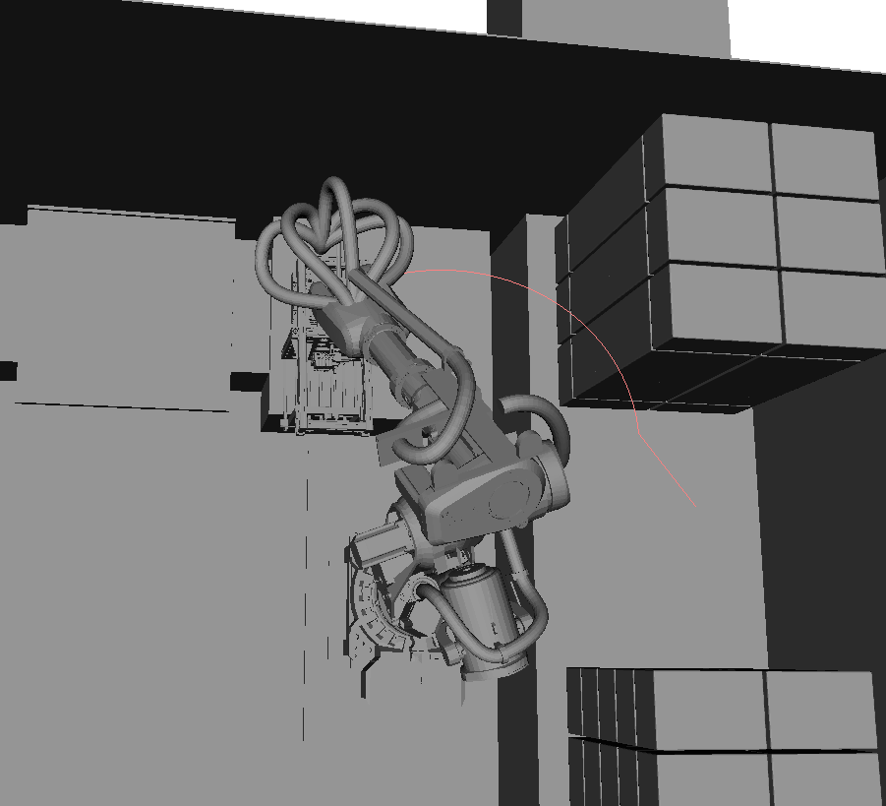

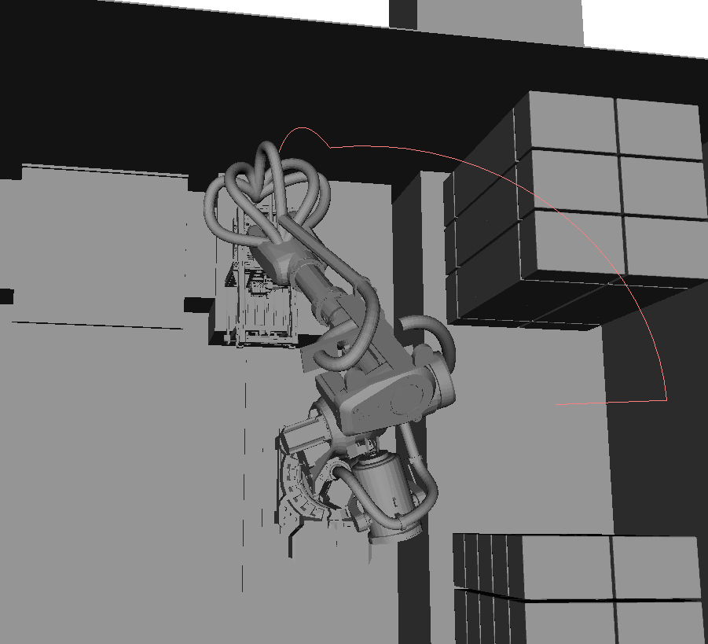
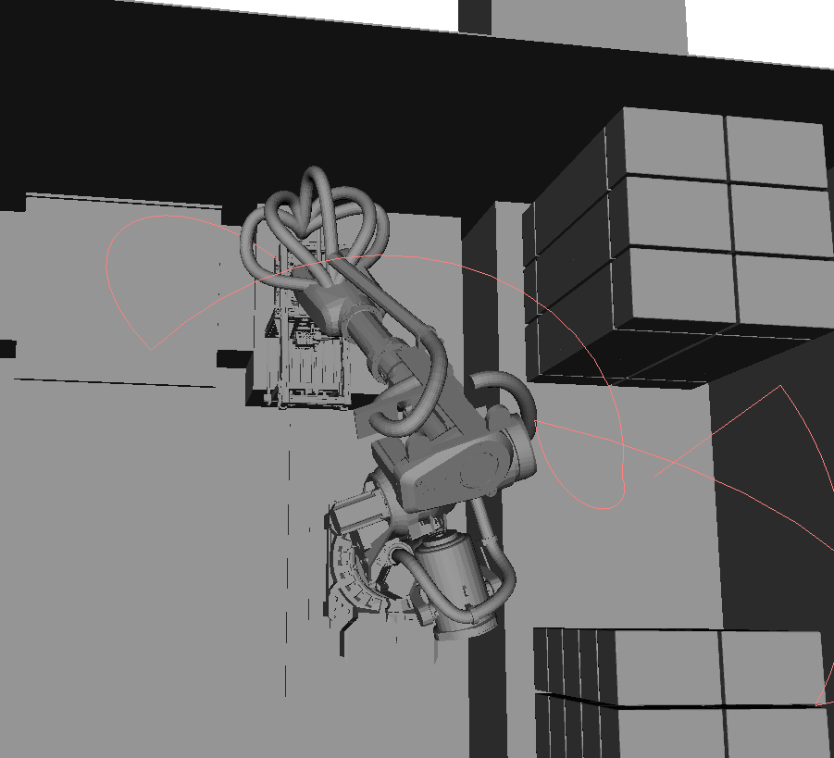
compare with other algorithms (1.0s)
Planner name | time | traj num | cost | minCollisionDis | averageCollisionDis
OMPL_BITstarDis | 2.33905 | 3 | 3.04257 | 0.137422 | 0.255957
OMPL_BITstar | 2.50562 | 5 | 2.71637 | 0.0526526 | 0.198566
OMPL_InformedRRTstar | 2.44707 | 5 | 4.66352 | 0.0562298 | 0.248452
OMPL_RRTConnect | 0.799708 | 7 | 10.4118 | 0.101096 | 0.285573

Slide 92
parameters test
case | time | traj num | cost | minCollisionDis | averageCollisionDis
stopOnSolnChange | 1.18 | 3.9 | 4.37(0.10) | 0.13 | 0.28
1.0 | 2.44 | 4.1 | 3.83(0.01) | 0.17 | 0.28
2.0 | 4.73 | 4.6 | 3.33 | 0.21 | 0.30
5.0 | 11.62 | 5.4 | 3.11 | 0.13 | 0.26
10.0 | 23.63 | 5.91 | 3.01(0.01) | 0.15 | 0.28
20.0 | 46.31 | 5.1 | 2.88 | 0.16 | 0.27

Slide 93
parameters test
first solution
Notes:
check ptc when a batch is over. overtime

Slide 94
parameters test 1.0s
case | time | traj num | cost | minCollisionDis | averageCollisionDis
K,no JIT | 2.44 | 4.1 | 3.83(0.01) | 0.17 | 0.28
R,no JIT | 2.44 | 5.7 | 5.20(0.23) | 0.18 | 0.29
R, JIT | 2.45 | 4.2 | 3.35(0.01) | 0.17 | 0.28
Notes:
JIT, as well as KN, is faster in small time limit;
but not significant in long time limit.

Slide 95
parameters test 1.0s
Prune fraction | time | traj num | cost | minCollisionDis | averageCollisionDis
NOT prune | 2.41 | 3.8 | 3.94 | 0.13 | 0.28
0.20 | 2.41 | 3.7 | 3.60(0.07) | 0.18 | 0.29
0.05 | 2.44 | 4.1 | 3.83 | 0.17 | 0.28
0.00 | 2.43 | 4 | 3.99 | 0.17 | 0.29

Slide 97
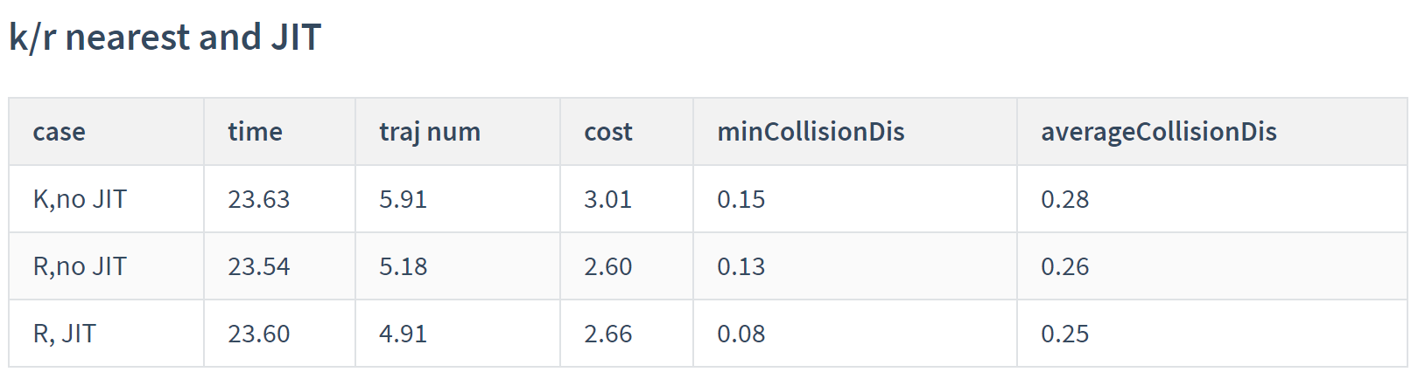
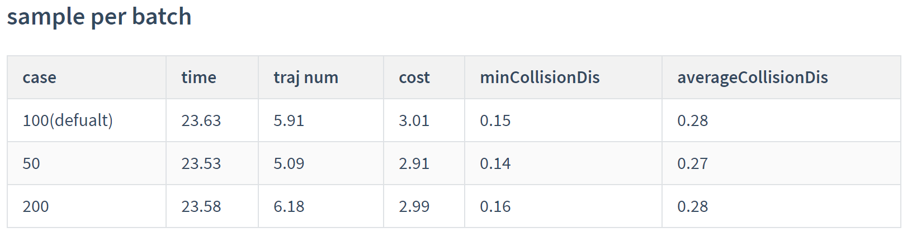
parameter test
nothing significant

Slide 98
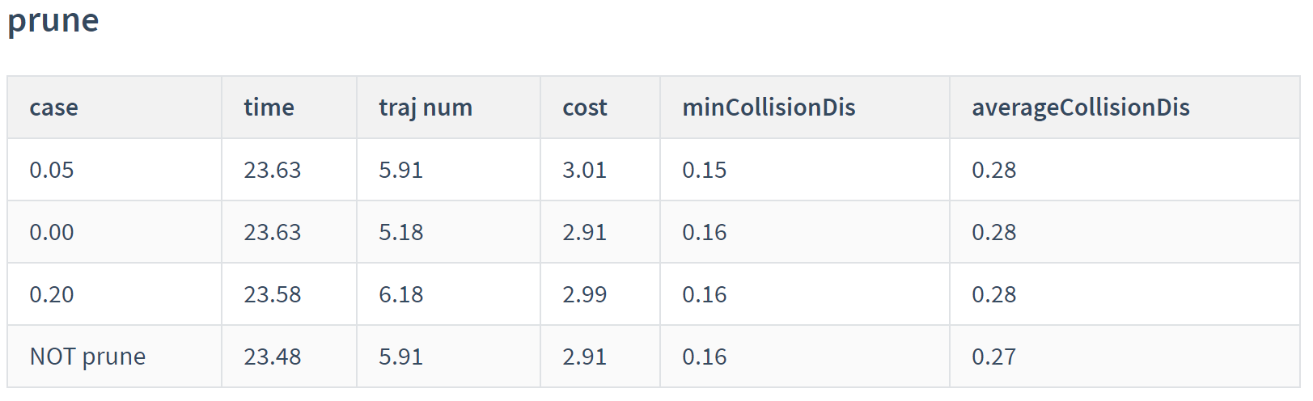
parameter test
nothing significant

Slide 99
Thanks ~

